Slide 1
Mergers and Acquisitions Strategic Focus
Professor Alexander Roberts Dr William Wallace Dr Peter Moles
Edinburgh Business School, Watt University, United Kingdom
Notes:
acquisition/ˌakwɪˈzɪʃ(ə)n/

Slide 2
Learning Objectives
• basic reasons why companies merge and/or acquire; • underlying logic behind the strategic rationale; • concept of strategic alternatives; • concept of national and international regulation; • concept of strategic focus; • idea of aligning focus with performance; • concept and operation of the value chain; • rationale behind the objective of strategic fit; • effects of change and strategic drift; • concept and process of characteristics mapping.
Notes:
By the time that you have finished this module you should be familiar with
some of the primary drivers behind merger failure, including the:
Reason /ˈriːz(ə)n/
Strategic /strəˈtiːdʒɪk/
rationale/ˌraʃəˈnɑːl/
focus/ˈfəʊkəs/

Slide 3
Some Common Questions about M&A
M&A are carried out primarily for either strategic or financial reasons.
In a strategic acquisition the acquirer is generally seeking to increase its long-term competitive advantage.
In a financial acquisition the acquirer is generally seeking to sell the target on at some point in the future for profit.
The primary difference between a merger and an acquisition is that in a merger both companies agree to merge and agree on mutually acceptable conditions through negotiation.
Notes:
Mutually /ˈmjuːtʃ(ʊ)əli/ tương hỗ, hỗ trợ

Slide 4
Some Common Questions about M&A
Companies are usually acquired by the payment of cash or by the transfer of shares.
Strategic focus is concerned with how a company focuses in on its core competencies.
Strategic drift is the tendency for companies to drift off the course that is necessary in order to achieve their strategic objectives. It also occurs when the external environment changes, rendering the strategic objectives obsolete, but the company continues to pursue the same strategic objectives.
In a strategic alliance, two or more companies work together and share skills and resources for the mutual benefit of both companies.
Strategic alliances are sometimes used as a form of ‘courtship’ as a prelude to the ‘full marriage’ proposition implied by full merger or acquisition
Notes:
Render (n/v) cause to be or become; make.
Sự trôi dạt theo chiến lược là xu hướng các công ty trôi dạt quá trình cần thiết để đạt được các mục tiêu chiến lược của mình. Nó cũng xảy ra khi môi trường bên ngoài thay đổi, làm cho mục tiêu chiến lược lỗi thời, nhưng công ty tiếp tục theo đuổi các mục tiêu chiến lược giống nhau.
Obsolete /ˈɒbsəliːt/ No longer produced or used; out of date.
Trong một liên minh chiến lược, hai hoặc nhiều công ty làm việc cùng nhau và chia sẻ kỹ năng và nguồn lực vì lợi ích chung của cả hai công ty.
Các liên minh chiến lược đôi khi được sử dụng như là một hình thức 'tán tỉnh' như là một bước mở đầu cho đề xuất 'hôn nhân đầy đủ' ngụ ý bằng cách sáp nhập hoặc mua lại toàn bộ
Alliance /əˈlʌɪəns/ liên minh
Prelude /ˈprɛljuːd/ an action or event serving as an introduction to something more important.
Core competencies: Năng lực cốt lõi

Slide 5
Some Common Questions about M&A
M&A may take place between companies that are either related or unrelated.
The acquisition of a related target may be made with the intention of reinforcing strategic focus.
Regulatory bodies are generally established by governments. They regulate on issues where a proposed merger or acquisition could provide the merged companies with the ability to affect prices within a given sector significantly.
A significant proportion of mergers appear not to achieve the original objectives established for them.
One of the primary sources of problems in achieving successful outcomes is the implementation process.
Mergers appear to develop in waves.
The current merger wave is sometimes referred to as the ‘globalisation’ wave.
Notes:
Các cơ quan quản lý thường được các chính phủ thành lập

Slide 6
Some Common Misconceptions about M&A
In many cases, when a company goes into a merger, it may have no experience of past mergers to guide it.
This problem is to some extent compounded by the lack of knowledge transfer in previously merged companies. Even companies with a successful track record of mergers and acquisitions often do not attempt to formalize and store their acquired knowledge from previous transactions.
Acquisitions can be extremely complex and can involve a considerable degree of risk.
In companies the decision on whether or not to merge or acquire/be acquired requires the approval of the shareholders.
Acquisitions are often ‘paid for’ by the transfer of shares in the acquirer rather than cash payments.

Slide 7
Some Common Misconceptions about M&A
It can be very difficult to assess the financial value of a target company. The true value is not always apparent from the balance sheet.
Target companies do not always object to being acquired. In some cases an acquisition could (for example) offer potential financial investment that the target needs for growth. Divested companies are often bought by other companies, although some continue to operate as separate entities for a considerable period of time.
The absorption of an acquired company can be complex and time consuming. In some cases the desired level of absorption may be found to be impractical.
Mergers and acquisitions can be equally difficult to bring to a successful conclusion.
Notes:
Divested companies công ty thoái vốn
Sự hấp thụ của một công ty mua lại có thể phức tạp và mất thời gian. Trong một số trường hợp, mức độ hấp thụ mong muốn có thể là "không thực tế".

Slide 8
Business Strategy and Corporate Strategy
It will be recalled from the introductory module that there are four primary underlying rationales for M&A. The four rationales are listed below. – Strategic rationale. – Speculative rationale. – Management failure rationale. – Financial necessity rationale.
Business strategy is concerned with how a company should best compete in each of its selected business areas.
Corporate strategy is concerned with business diversification and primarily with the businesses the company should be active in.
Companies acquiring related companies appear to gain more from the merger in the long term.
Notes:
Strategy /ˈstratɪdʒi/
rationale/ˌraʃəˈnɑːl/

Slide 9
Business Strategy and Corporate Strategy
Notes:
Tactic /ˈtaktɪk/ chiến lược

Slide 10
Business Strategy and Corporate Strategy

Slide 11
Business Strategy and Corporate Strategy
Companies sometimes make unrelated acquisitions as a means of distributing market risk across a range of industries and sectors.
Business M&A are sometimes made with the objective of attracting shareholders.
In order to justify a strategic merger the company must be sure that the merger or acquisition represents the best use of any or all capital in order to promote its strategic objectives.
In most cases, acquisitions provide better options for growth than mergers. It is generally easier to buy a company and take it over than it is to merge with it.
A strategic alliance is essentially the formalised cooperation between two organisations in order to achieve common benefit.
Notes:
Một liên minh chiến lược chủ yếu là hợp tác chính thức giữa hai tổ chức để đạt được lợi ích chung.

Slide 12
Business Strategy and Corporate Strategy
A strategic alliance is not a loose agreement. In most cases there is a need for the companies to be bound together in a substantive manner.
The literature on strategic alliances and partnerships suggests two main views. These are the resource-based view and the risk-based view.
The resource-based view assumes that strategic alliances rely on the fact that a company’s core competencies are usually based on that company’s unique resources. In this respect a strategic alliance is one way of pooling the core competencies of the various alliance partners for the common good.
The risk-based view recognises that mergers, acquisitions and strategic partnerships are risky. In general terms, however, the risk is less in a strategic alliance because the two companies are less rigidly tied together and there is often a time limit to the alliance.

Slide 13
Business Strategy and Corporate Strategy
One of the primary risks associated with a strategic alliance is that of the hidden agenda. One or more partners to the alliance may in fact join the alliance with a hidden agenda. This agenda could include anything from the exploitation of a successful brand to the acquisition of technology.
Partner risk relates to the risk of there being problems in the degree of cooperation that develops between the various members of the strategic alliance.
Outcome risk relates to the likelihood of a given strategic objective or set of objectives not being achieved or, if they are achieved, of the outcome turning out to be less than or different from expectations.
Strategic mergers and acquisitions should generate a new organisation that has a good strategic fit.

Slide 14
Business Strategy and Corporate Strategy
Obvious targets for unrelated acquisition include companies with undervalued assets or companies in financial difficulties. In the former there is potential for significant capital gains whereas in the latter there is the potential to acquire the target at a bargain price.
In recent years there has been a trend towards narrow diversification with the emphasis on the creation of value and competitive advantage in a smaller number of carefully selected industries or sectors, rather than spreading corporate investments more or less indiscriminately across a wide range of different sectors and industries.
In both related and unrelated diversification, there is always the possibility that an acquired company does not fulfil the purpose for which it was acquired. If this occurs, and depending on the degree to which the acquired company does not perform, it may become necessary for the company to be divested or de-merged.

Slide 15
Business Strategy and Corporate Strategy
There are numerous reasons why this situation could arise. Some examples are listed below. – The acquired company may simply not perform as well as expected. – Key staff may leave during or immediately after the acquisition. – It may not be possible to incorporate the culture of the acquired company. – Cultural resistance may create insurmountable integration problems. – The attractiveness of the particular sector or industry may change over time.
There are three primary approaches to divestiture:
sell the company;
set the company up as an independent trading entity and spin it off; and
put the company into liquidation.

Slide 16
Business Strategy and Corporate Strategy
There are numerous reasons why turnaround might be preferable to divestiture. – Playing the long game. – Restoring the subsidiary company to profitability. – Balancing the portfolio. – Restructuring the portfolio.
Multinational diversification raises a different set of strategic issues. Strategic planners have to develop a range of strategies in order to achieve a range of strategic objectives.

Slide 17
National and International Regulators
Different overall regulatory bodies
Vietnam
http://www.moj.gov.vn/vbpq/lists/vn%20bn%20php%20lut/view_detail.aspx?itemid=16744
http://www.moj.gov.vn/vbpq/lists/vn%20bn%20php%20lut/view_detail.aspx?itemid=16744#Dieu_152
http://www.moj.gov.vn/vbpq/lists/vn%20bn%20php%20lut/view_detail.aspx?itemid=16744#Dieu_153
http://moj.gov.vn/vbpq/lists/vn%20bn%20php%20lut/view_detail.aspx?itemid=17492#Dieu_34

Slide 18
The Concept of Strategic Focus
Professor Robert’s process model for strategic focus comprises four stages. – Strategic planning. – Making strategies work. – Project management. – Strategic risk management
Companies can choose to adopt a focused strategy or they can chose to diversify their interest areas. A focused strategy is one that concentrates on the key competencies of the organisation rather than on a range of different interest areas.
In moving towards strategic focus a company may: – divest non-core productive companies; – liquidate non-core unproductive companies; – outsource non-core activities; – realign strategic objectives; – invest in order to realign.

Slide 20
The Concept of Strategic Focus
Each action involves a considerable degree of organisational change. The scope and timescales for the change are set by the degree of focusing that is required. In order to determine these variables the senior managers usually: – conduct a thorough analysis of the existing organisation; – consider existing and likely future environmental conditions; – carry out a thorough diagnostic evaluation of any problem areas; – clarify the core competencies and purpose of the organisation.
Notes:
Mỗi hành động liên quan đến một mức độ đáng kể của sự thay đổi tổ chức. Phạm vi và thời gian thay đổi được xác định bởi mức độ tập trung được yêu cầu. Để xác định những biến số này, các nhà quản lý cấp cao thường:
• Tiến hành phân tích kỹ lưỡng tổ chức hiện tại
• Xem xét các điều kiện môi trường hiện tại và khả năng trong tương lai
• Thực hiện đánh giá toàn diện về bất kỳ vấn đề nào
• Làm rõ cốt lõi Năng lực và mục đích của tổ chức.

Slide 21
The Concept of Strategic Focus
Senior managers use this information to: – evaluate current and expected conditions; – clarify the core competencies of the organisation; – develop a vision of where the company should be going; – establish focused strategic objectives.
Strategic change is achieved through two primary elements of Professor Roberts’ Strategic Focus Wheel. These are making strategies work and project management. In most cases strategies can be made to work only by changing things, and project management offers the ideal set of tools for managing strategic change.
Strategic change should also be regarded as a cascade function. Successful cascade occurs when the strategic change is broken down to a level where responsibility can be passed to individual functional managers and individual strategy-compatible functional objectives can be established.
Notes:
Các nhà quản lý cấp cao sử dụng thông tin này để:
- đánh giá các điều kiện hiện tại và dự kiến
- làm rõ các năng lực cốt lõi của tổ chức
- phát triển một tầm nhìn về nơi mà công ty nên đi
-
Thay đổi chiến lược được thực hiện thông qua hai yếu tố chính của Chiến lược Focus Wheeler của Giáo sư Roberts. Đây là những chiến lược làm việc và quản lý dự án. Trong hầu hết các trường hợp, các chiến lược có thể được thực hiện chỉ bằng cách thay đổi mọi thứ và quản lý dự án cung cấp bộ công cụ lý tưởng để quản lý thay đổi chiến lược.
Thay đổi chiến lược cũng nên được coi như là một chức năng thác nước. Thành công thác xảy ra khi thay đổi chiến lược được chia nhỏ đến mức mà trách nhiệm có thể được thông qua cho các cá nhân quản lý chức năng và các mục tiêu chức năng tương thích với các mục tiêu riêng lẻ có thể được thiết lập. Thiết lập các mục tiêu chiến lược tập trung.

Slide 22
Aligning Focus with Performance
The real significance of value chain management becomes clear when companies integrate across organisational boundaries with each other in terms of: – supply-chain management; (SCM) – customer relationship management; (CRM) – supplier relationship management. (SRM)
SCM, CRM, SRM are the three key integrative elements of the value chain. They really represent visibility.
This visibility is essential where companies generate products in different locations, using a range of outsourced suppliers in order to service powerful customer bases. Once established, these elements allow the value chain to be fully flexible and responsive to changes in the external environment.
Notes:
Align: sắp xếp, liên kết
Tầm quan trọng thực sự của quản lý chuỗi giá trị trở nên rõ ràng khi các công ty tích hợp qua các ranh giới tổ chức với nhau về: Quản lý chuỗi cung ứng, Quản lý quan hệ khách hàng, Quản lý quan hệ nhà cung cấp.
Quản lý chuỗi cung ứng, quản lý quan hệ khách hàng và quản lý mối quan hệ nhà cung cấp là ba yếu tố tích hợp chủ chốt của chuỗi giá trị? Họ thực sự đại diện cho tầm nhìn.
Tầm nhìn này rất quan trọng khi các công ty tạo ra các sản phẩm ở những vị trí khác nhau, sử dụng nhiều nhà cung cấp bên ngoài để phục vụ các cơ sở khách hàng mạnh mẽ? Một khi đã được thiết lập, các yếu tố này cho phép chuỗi giá trị để được hoàn toàn linh hoạt và đáp ứng với những thay đổi trong môi trường bên ngoài.

Slide 23
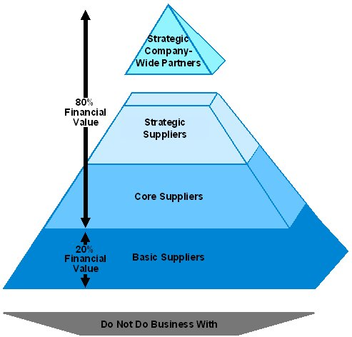
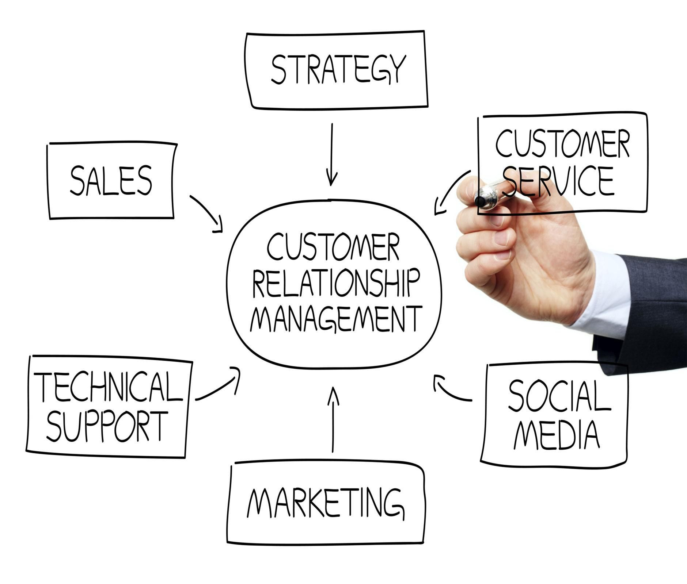

Slide 24
Aligning Focus with Performance Porter’s supply chain:
Notes:
Chuỗi cung ứng

Slide 25
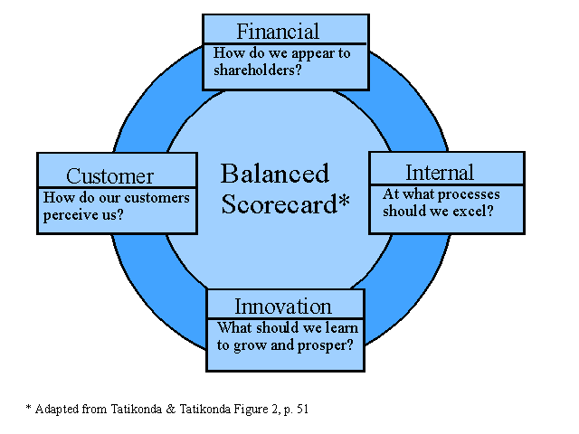
Aligning Focus with Performance The Balanced Scorecard (BSC)

Slide 26
Aligning Focus with Performance
In the BSC, in most cases, the financial imperative will have a number of drivers. The imperative of increasing shareholder value might be driven by: – revenue strategy. – productivity strategy.
In most cases there are a number of options for revenue growth. These include: – the introduction of new products; – the introduction of new outlets; – increasing prices.
In most cases the options for increasing productivity include: – reducing costs; – reducing risk; – increasing efficiency.

Slide 27
Change and Strategic Drift
The impact of unexpected change tends to be most pronounced where the M/A takes place over a considerable period of time.
Where a M/A integration takes months or years to complete, there is an increasing likelihood of some unexpected element making an impact on the integration process.
Change and strategic drift are extremely important in the consideration of the long-term viability of M&A. Relatively small degrees of drift may not have a strategic level impact. A series of minor shifts may, however, have a much more significant long-term impact.
Examples of causes of strategic drift include the following:
– The strategy may have been incorrectly planned. – The original objectives may have been incorrectly assessed. – The original objectives may have now changed. – Unforeseen events may impact on the implementation of the strategy. – New strategies may have evolved.
Notes:
Thay đổi và trôi dạt chiến lược là vô cùng quan trọng trong việc xem xét khả năng tồn tại lâu dài của M & A. Mức độ trôi dạt tương đối nhỏ có thể không có tác động ở mức chiến lược. Tuy nhiên, một loạt các thay đổi nhỏ có thể có tác động lâu dài đáng kể hơn.
Các mục tiêu ban đầu có thể đã được đánh giá không chính xác? Các mục tiêu ban đầu có thể đã thay đổi. Các sự kiện không lường trước có thể ảnh hưởng đến việc thực hiện Chiến lược. Các chiến lược mới có thể đã phát triển.

Slide 28
Change and Strategic Drift
Critical success factors (CSFs) are those elements of the performance of the organisation critical to its success.
Key performance indicators (KPIs) are generally taken as measures of the effectiveness of the organisation in achieving its CSFs.
Critical business activities (CBAs) can be used to evaluate the contributions of specific activities towards achieving CSFs.

Slide 29
Change and Strategic Drift

Slide 30
Change and Strategic Drift
Important external influences that can change and cause drift are:
– customer demand; – competitor behaviour; – interest rates; – exchange rates, – innovation and new technologies; – statutory regulation.

Slide 31
Change and Strategic Drift
In general terms it is possible to say that external environmental influences are: – outside the control of the organisation; – potentially large impact; – potentially complex; – interdependent of internal drift drivers.
Scenario planning is basically a method for considering strategic objectives in the context of possible changes in the external environment.
Individual scenarios are generally considered as part of a range of possible scenarios including: – the best-case scenario; – the mid-case scenario; – the worst-case scenario.
Scenario planning is a particularly useful approach in mergers and acquisitions because the success of the merger depends on certain future environmental conditions being met.
The attractiveness of a potential target is regulated by a series of environmental drivers.
Notes:
Nói chung, có thể nói rằng các ảnh hưởng của môi trường bên ngoài là: - nằm ngoài sự kiểm soát của tổ chức ;; - có khả năng tác động lớn; - có khả năng phức tạp - phụ thuộc lẫn nhau vào các trình điều khiển trôi giạt nội bộ.
Lập kế hoạch kịch bản về cơ bản là một phương pháp để xem xét các mục tiêu chiến lược trong bối cảnh có thể thay đổi môi trường bên ngoài.
Các kịch bản riêng lẻ thường được coi là một phần của một loạt các kịch bản có thể bao gồm: - kịch bản trường hợp tốt nhất - kịch bản giữa các trường hợp - kịch bản trường hợp xấu nhất?
Lập kế hoạch kịch bản là một cách tiếp cận đặc biệt hữu ích trong việc sáp nhập và mua lại vì sự thành công của việc sáp nhập phụ thuộc vào các điều kiện môi trường nhất định trong tương lai.
Sự hấp dẫn của một mục tiêu tiềm năng được điều chỉnh bởi một loạt các trình điều khiển môi trường.

Slide 32
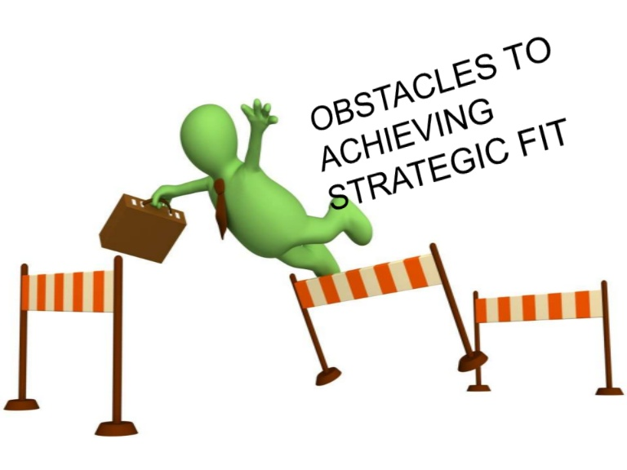
Characteristics Mapping
Characteristics mapping is a tool for evaluating how well two companies fit together in a strategic sense.
Characteristics mapping typically uses a tabular format showing company characteristics against strategic fit drivers. Typical company characteristics are related to the company’s functions or activities.
Typical strategic fit drivers include: – degree of difference; – extent of change required; – likelihood of achieving change; – extent to which the change is essential.
Notes:
Các bản đồ đặc điểm thường sử dụng một định dạng bảng biểu cho thấy các đặc tính của công ty đối với các trình điều khiển phù hợp với chiến lược. Đặc điểm của công ty điển hình có liên quan đến chức năng hoặc hoạt động của công ty.
Các trình điều khiển phù hợp với chiến lược điển hình bao gồm: - mức độ khác biệt, - mức độ thay đổi được yêu cầu, - khả năng đạt được sự thay đổi, - mức độ thay đổi là điều cần thiết.

Slide 33
Characteristics Mapping
The final characteristics map gives an indication of the degree of change necessary to achieve a successful merger or acquisition integration.
The degree of change indicator is also representative of the level of risk likely to be involved in proceeding with the M/A.
High-risk aspects can be identified by the use of a risk map. Aspects with a high likelihood and high impact should be approached with great care, usually controlled by the use of some form of specific risk management plan.
All individual characteristics mapping risks should be included within individual risk management action plans which, in turn, should be frequently reviewed and monitored.

Slide 34
Questions

Slide 35
Questions/Some Common Questions about M&A
2.1 Mergers and acquisitions are always carried out for strategic reasons. T or F? 2.2 A speculative acquisition cannot be regarded as offering any long-term competitive advantage. T or F? 2.3 Acquisitions are nearly all paid for in cash. T or F? 2.4 Irrespective of the measurement system used, mergers and acquisitions hardly ever add long-term competitive advantage. T or F? 2.5 The primary difference between a merger and an acquisition is that in a merger both companies agree to merge, usually after a process of negotiation. T or F? 2.6 Mergers appear to take place in definable waves. T or F? 2.7 A related acquisition may be made in an effort to increase the degree of strategic focus. T or F?

Slide 36
Questions/Some Common Misconceptions about M&A
2.8 Most companies have extensive mergers and acquisitions experience. T or F? 2.9 It is relatively easy to value a potential target, as all necessary information is available on the balance sheet. T or F? 2.10 Acquisitions are almost always hostile. T or F? 2.11 Divested companies are rarely bought by other companies. T or F?

Slide 37
Questions/ Business Strategy and Corporate Strategy
2.12 Business strategy can be regarded as ‘the opposite’ of corporate strategy. T or F? 2.13 Corporate strategy is primarily concerned with the development of strategic focus. T or F? 2.14 Companies acquiring related companies appear to gain more from the merger in the long term. T or F? 2.15 Diversification across a range of different sectors or industries is an effective way of spreading business risk. T or F?
2.16 In most cases it is easier to acquire a company and integrate it with the existing company than it is to merge with another company. T or F? 2.17 A strategic alliance offers all of the benefits of an acquisition but with less risk. T or F?

Slide 38
Questions/ National and International Regulators
2.18 All proposed mergers and acquisitions are subject to national regulation. T or F? 2.19 National and international regulators operate closely to ensure that rulings are compatible. T or F? 2.20 National regulators can block any proposed merger or acquisition. T or F?

Slide 39
Questions/ The Concept of Strategic Focus
2.21 All companies prefer to adopt strategies based on strategic focus. T or F? 2.22 Strategic change is a usual necessary component of any move towards increasing the degree of strategic focus. T or F? 2.23 Strategic change usually implies increased strategic risk. T or F? 2.24 The Strategic Focus model contains four primary components. T or F? 2.25 Companies usually attempt to improve the degree of strategic focus as a short-term attempt to improve productivity. T or F?

Slide 40
Aligning Focus with Performance
2.26 Value chain management is basically the same as supply chain management. T or F? 2.27 Customer relationship management is one of the three primary components or value chain management. T or F? 2.28 In-bound logistics is one of Porter’s supply chain components. T or F?

Slide 41
Change and Strategic Drift
2.29 The impact of imposed strategic change tends to be time dependent. T or F? 2.30 Imposed strategic change is one driver for strategic drift. T or F? 2.31 Powerful external influences on strategic drift are sometimes referred to as key environmental influences (KEIs). T or F? 2.32 Scenario planning is basically a method for considering strategic objectives in the context of possible changes in the external environment. T or F?

Slide 42
Characteristics Mapping
2.33 Characteristics mapping is a way of measuring the suitability of a potential target in terms of the extent of change required and the likelihood of achieving this change. T or F? 2.34 In characteristics mapping it is usual practice to assign weightings to the various fit drivers. T or F? 2.35 The characteristics map acts as the basis for the acquisition project risk management system. T or F?

